Slide 1
Infosecurity Belgium
March, 2019
Notes:
OPTION A

Slide 2

What if security started with data?
SUSTAIN
We’d efficiently sustain our secure state
PREVENT
Only the right people would have access
DETECT
We’d monitor it for abuse
DATA
We’d know where our sensitive data lives

Slide 3
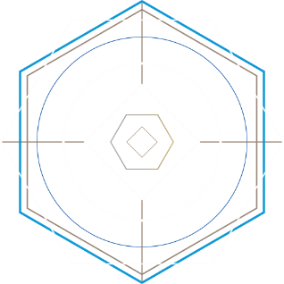



Many questions
Is my data at risk?
Am I compliant?
Can I detect a breach?
Is my data exposed?
Who does it belong to?
Who is accessing our data?
Where is my regulated data?
Should I delete it?
Is anyone stealing it?
How hard is it to recover from a breach?
…Lots more questions…

Slide 4
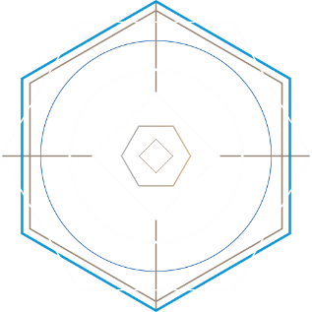
THREE USE CASES
DATA PROTECTION
COMPLIANCE
THREAT DETECTION & RESPONSE
ONE PLATFORM

Slide 5






For many data stores…
Windows
Office 365
Unix/Linux
SharePoint
Exchange
NAS
Box

Slide 6











Varonis Data Security Platform
ENTERPRISE DATA STORES AND INFRASTRUCTURE
ANALYTICS & AUTOMATION
USE CASES
DATA PROTECTION
Users &
Groups
Permissions
Windows
Office 365
Exchange
Content
Classification
Access Activity
COMPLIANCE
Unix/Linux
SharePoint
NAS
Perimeter
Telemetry
AD
Telemetry
Box
Directory
Services
Edge
Services
THREAT DETECTION & RESPONSE

Slide 7
Why do these keep happening?
Notes:
So, why do insiders and outside attackers keep hitting our unstructured data systems? Why does this keep happening?

Slide 8

Workstations
Applications
Active Directory
Mobile Devices
Perimeter
Network
Yesterday’s security vision
Notes:
We’ve been following the brightest lights when it comes to data security, too.
We shine a light with our SIEM, thinking if we put enough there, we’ll be able to see threats.
Antivirus and next gen endpoint protection is on all of our devices, but attacks still get in.
UBA is a light that’s only as strong as the behavior you’re giving it, and there’s not enough context to connect the dots and not get drowned in false positives.
Looking at AD only gives us some of the problem. If our data’s exposed, it’s partly because users are in too many groups and AD is probably going to be involved in an attack. But looking at AD only gives you part of the story and it doesn’t help you lock down exposed data or even know where you’re important files are.
Most security spending is at the perimeter of the network, but a determined adversary can probably get in, and your perimeter can’t protect you from insider threats.
DLP can tell you part of the story too – where you’ve got sensitive data. But it still can’t tell you where that data might be exposed, how it’s being used or misused, who it belongs to, or should be able to see it.
None of our brightest lights leads us to the right place when it comes to data. How do we know? Because data keeps getting stolen, leaked, or hijacked by ransomware.
The reality is that trust in data security is failing because the brightest lights aren’t leading us to the right place.

Slide 9

WannaCry
Equifax
Cryptolocker
Sony
etc…
…and every “DataBreach - malware/ransomware” attack.
Notes:
Because our files are completely in the dark when it comes to security, ransomware like Cryptolocker and Locky has exploded over the last few years. Ransomware highlights how bad the problem is - it attacks data that’s in the dark.

Slide 10





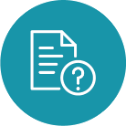

Data is in the Dark
Who is accessing, modifying, moving, deleting files and email?
Who has access to files, folders, mailboxes?
Which data is exposed to too many people?
There are many questions IT and the business can’t answer easily:
Which files contain critical information?
What data isn’t being used?
Who owns data and how do I get them involved?
Notes:
It’s because data is in the dark. Think about the questions you should be able to answer if your data is secure:
Where’s my sensitive data, and where is it exposed?
Who’s got access to what?
What’s being used, and by whom? What’s stale – what can I get rid of?
Who owns this data?
Maybe most critically…

Slide 11
DATA
It’s all about DATA
Notes:
To keep data safe, our brightest light needs to be on the data itself.

Slide 12
Why should we change now?
Notes:
Maybe this all makes sense to you, but you might still be thinking, “We’ve had file shares for more than 20 years. Why do we suddenly have to change the way we think about securing data?”

Slide 13



Secular Trends
DATA GROWTH
Hybrid CLOUD
CYBER THREATS
The amount of data created in the world will grow to 163 Zettabytes (or 151 trillion gigabytes) in 2025, representing a nearly tenfold increase from the amount created in 2016. ⁽¹⁾
Through 2020, more than 85% of enterprises adopting a cloud-first strategy will continue to host business-critical applications in traditional data center environments. ⁽²⁾
By 2025, almost 90% of all data will require a meaningful level of security, but less than half will be secured. ⁽¹⁾
⁽¹⁾ IDC Research — Data Age 2025: The Evolution of Data to Life-Critical
⁽²⁾ Gartner Research - Deliver Data Center Modernizing Using Three-Cloud Complementary Approaches
Notes:
Data is growing faster than it ever has, and it’s accelerating. Think about how much data you’ve got now. Now think about how much more you have this year than just two or three years ago. What about in the next decade?
We live in a hybrid, interconnected world. Not only is there more data, more of it is potentially accessible not just by the employees in our home office, but by everyone in the world.
The threats are increasing. In a world where anyone can lock down your files and get paid anonymously through cryptocurrency, the incentive to attack is higher than its ever been.
So we’ve got more data than ever, it’s more accessible than ever, and the risks are higher than they’ve ever been, and growing.

Slide 14



Industry Changes
BOARD
AWARENESS
Adoption AND
STANDARDIZATION
REGULATION
Board of Directors are now required to address cyber risks and demonstrate appropriate awareness and action.
A data-centric approach to security is becoming a standard. Almost every breach involves data assets in the form of files, emails and video that are stored in growing on-premises and cloud file systems.
The confluence of notable attacks, media attention, and public outcry has led to new data-centric regulations.
Notes:
We’re seeing significant, broad changes in how the industry approaches data security as well. Keeping data private and secure is not longer just an IT problem – cybersecurity has board-level visibility and significant breaches won’t just be felt in the IT department.
Securing data, not just the surrounding systems, is becoming a standard and it’s being enforced by regulation like the GDPR and ISO 27001&2

Slide 15

What if we could start over?
Notes:
What would we do if we could just start over. If we could complete redo all of our thinking and spending on cybersecurity?
Knowing what we know now, we’d probably start at the data. We’d make sure to know what’s sensitive and what’s not, and where it all is.
We’d know exactly who could access it, and why. We’d know who it belonged to, and we’d record every time anyone touched it, for any reason.
We’d know who our users are, who the admins and service accounts and executives are, and we’d watch what they did – how they got in, where they went, and especially what data they accessed.
We’d know what’s normal. Because we know what’s normal, we’d be able to tell when something went wrong.
If we could start over with data security, we’d start from the data and treat files like finances.

Slide 16



Detect
Prevent
sustain
insider threats by analyzing data, account activity, and user behavior.
disaster by locking down sensitive and stale data, reducing broad access, and simplifying permissions.
a secure state by automating authorizations, migrations, & disposition.
Notes:
Our methodology makes sense. Varonis maps your environment and puts monitoring on data that often has never had it so we can detect threats to your core assets. By fixing problems like global access and safely reducing access to make sure only the right people have access to what they need, we help prevent the kinds of breaches that can take down a business. And with automation and by involving data owners, we help sustain a secure state without a lot of manual effort.

Slide 17


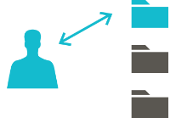


IMAGINE
We know where our sensitive data lives
Only the right people have access
Cyber threats are detected and stopped
Sustain a secure state without manual effort
Notes:
Varonis isn’t a set of tools, it’s a platform, and we’re selling a vision for our customers where they know where there most sensitive and valuable data is and can make sure that only the right people have access to it. They treat their data like their dollars, wherever it is, and can detect and stop the attacks they know are already here and prevent future ones by keeping the doors locked. And that because this isn't a rehash of the same approach they've taken for years, they'll finally be able to sustain this model by marrying people, process, and new technology that includes automation. Because we know the users, the directories, the data, and the activity, we’re in a place to become the most important security analytics company in the world.

Slide 18








Data Security Platform
ENTERPRISE DATA STORES AND INFRASTRUCTURE
COLLECTION AND ANALYTICS
USE CASES
AUTOMATION
Threat Detection
Data Classification
Access Governance
Risk Reduction
Regulatory Compliance
Remediation
Access Management
Migration
Disposition
Alert Response
Windows
Office 365
Exchange
Users &
Groups
Permissions
Unix/Linux
SharePoint
NAS
Content
Classification
Access Activity
Directory Services
Perimeter
Telemetry
PERIMETER DEVICES
Proxy
VPN
DNS
Commit changes back to data stores and directory services

Slide 19
The Journey of value

Slide 20

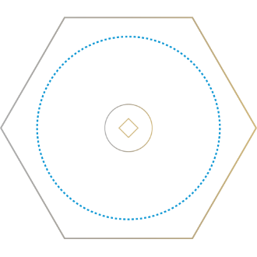


Operational Journey 2019
1. OPERATIONALIZE
Train
Report
Apply labels
Index
2. FIX
Eliminate issues
Archive stale data
Eliminate global access
Quarantine sensitive data
3. TRANSFORM
Simplify permissions
Identify and assign owners
4. SUSTAIN
Automate authorization
Automate retention
RISK ASSESSMENT
DATA PROTECTION
COMPLIANCE
PCI, HIPAA, GDPR, SOX, ITAR, GLBA
Deploy Varonis
Discover privileged accounts
Classify sensitive data
Baseline activity
Prioritize risk
1. INTEGRATE
Confirming Privileged Account Discovery
Enable alerts and methods
Connect to SIEM
Create Incident Response Plans
2. OPERATIONALIZE
Tune alerts
Automate response
Test incident response plans
THREAT DETECTION & RESPONSE

Slide 21
Incident Response Management

Slide 22
Discovery Timeline for Data Breaches

Slide 23
How does a typical cyber attack work?
Attackers get in
They learn your systems and accounts
They move around and escalate privileges
They find data they want
They take data out
An account or a workstation gets compromised via phishing, malware injection or brute-force attack
Then an attacker does some low & slow reconnaissance
Attackers escalate privileges & move laterally, maybe exploiting Kerberos vulnerabilities & pass the ticket attacks
Eventually they have an administrator or service account that can access the data they want.
They access it slowly and then exfiltrate it – maybe through DNS.

Slide 24
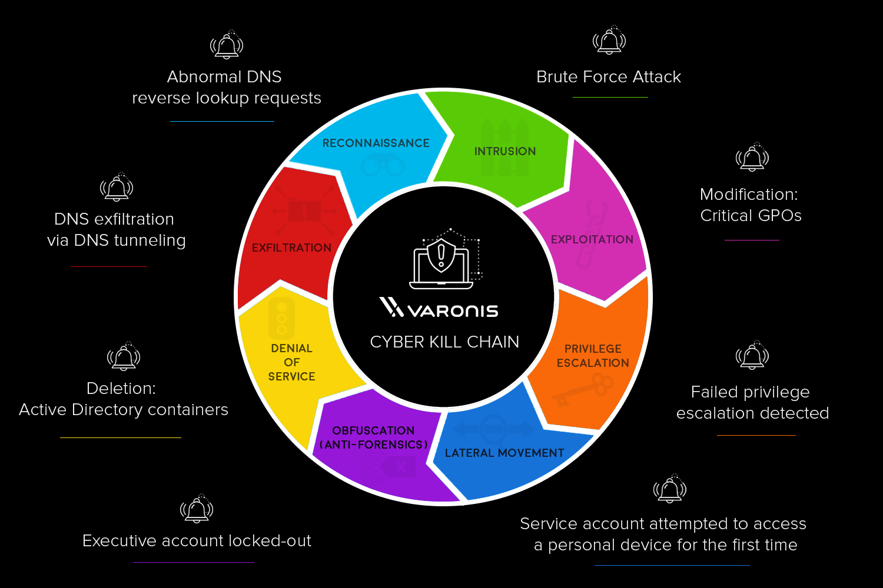
Attack stages: the cyber kill chain

Slide 25
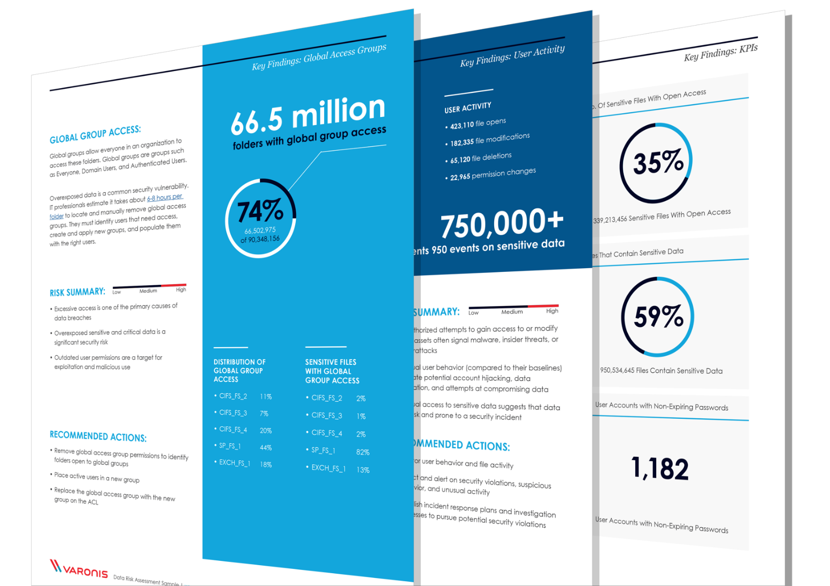
Get a Free Data Risk Assessment (Varonis booth)
Free of charge
Non-intrusive
Valuable reports quantify risk and diagnose issues such as:
What kind of sensitive data do I have? (PCI, SOX, PII, etc.)
Where is sensitive data overexposed?
Who has access to what?
Where are using acting strangely or maliciously?
What’s being used and what’s not?

Slide 26

Journey to safety
Notes:
One you’ve got lights in the right place, you’re far safer. Like the turtle popping out of the sand, the brightest light you’ll see will lead you where you’re supposed to go.

Slide 27
Jeremy Agenais
Kris Bijnens

